Slide 1

XML Review, XPath
3 March 2023

Slide 2

XML

Slide 3
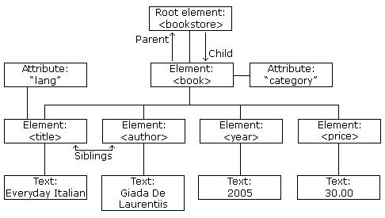
XML Structure
Hierarchical
Tree-like

Slide 4
Nodes
An implied root-level node. Contains everything, including the root node.
The topmost element of a document. Contains all other parts of a document. | <TEI> <html>
The name for a structure to be coded | <body> <div> <pb/>
Information about an element. | <div type=“chapter”> <name ref=“p0002”>
Textual data stored inside elements. | <l>Lord, what fools these mortals be!</l>
Notes that are not processed when reading an XML document. | <!--Fix ref attributes throughout-->
Document Node
Elements
Attributes
Text Nodes
Comments
Root Node
An implied root-level node. Contains everything, including the root node.

Slide 5
XML Relationship Structure
Relationships
Modifiers
Ancestor
Parent
Descendant
Child
Sibling
-or-self
following-
preceding-

Slide 6
Processing Instructions and Namespaces
<?xml version="1.0" encoding="UTF-8"?>
XML declaration. This is a processing instruction that identifies the type of document as XML. The version number specifies which version of XML is being used, while the encoding attribute determines which encoding character set is used. UTF-8 is a good default.
<?xml-model href="http://www.tei-c.org/release/xml/tei/custom/schema/relaxng/tei_all.rng" type="application/xml" schematypens="http://relaxng.org/ns/structure/1.0"?> <?xml-model href="http://www.tei-c.org/release/xml/tei/custom/schema/relaxng/tei_all.rng" type="application/xml" schematypens="http://purl.oclc.org/dsdl/schematron"?>
Schema declarations. These are processing instructions that associate the XML file with particular schemas.
<TEI xmlns="http://www.tei-c.org/ns/1.0">
<TEI> is our root element, which will open and close the document.
The xmlns attribute is a namespace, telling the document that we are using the TEI rules.

Slide 7
Well-Formed vs. Valid
Well-formed
Valid
Structure
All elements are nested properly
Elements can be anything.
Schema
All elements are nested properly and conform to a set of rules as defined in the processing instructions (e.g., TEI)

Slide 8
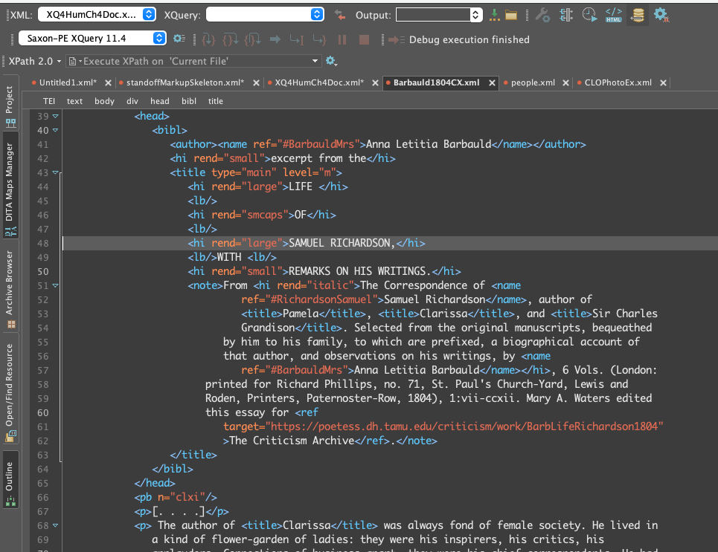
Examining XML in Oxygen

Slide 9
Text
encoding
XML-TEI
XPath XQuery
XSLT
transforming
querying
constraining
ODD & Schematron

Slide 10

Break (10 minutes)

Slide 11

XPath

Slide 12
Descriptive vs Presentational Markup
The goal of XML (and, more broadly, HTML) is to describe what data is.
One XML document can become lots of other kinds of documents (HTML, PDF, etc.)
Other languages are used to decide how each element is presented (e.g., a CSS file decides how an HTML file is displayed. See www.csszengarden.com for example)

Slide 13
Xpath vs. Xquery VS. XSLT
XPath
XQuery
XSLT
Navigating XML structured documents and running simple queries and functions.
Foundational for both XQuery and XSLT.
A language for manipulating XML nodes and data.
Queries XML documents and XML databases.
Transforms XML documents
Overlap
These three languages are complementary and are often used and developed in tandem. XPath gives us the vocabulary (or syntax) to talk to XML documents, while XQuery and XSLT allow us to do things with XML documents. What can be done in one can, generally, be done in the other, though with varying degrees of difficulty.

Slide 14
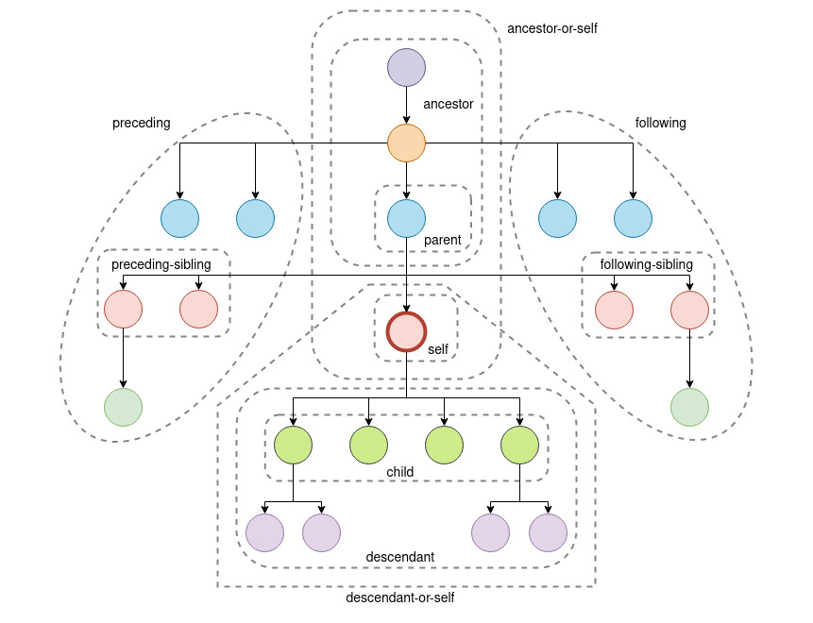
Xpath Axes

Slide 15
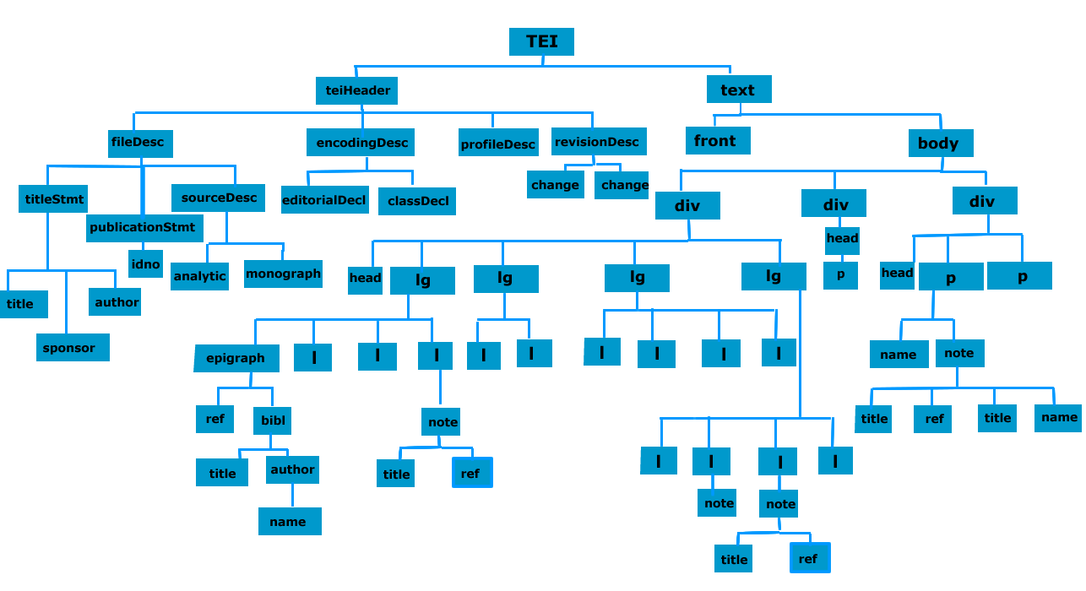

Slide 16
Node Tests
Used to target nodes in XML documents
text( ) matches text nodes
element( ) matches element nodes
attribute( ) matches attribute nodes
comment( ) matches comment nodes
node( ) matches all types of nodes

Slide 17
Running Xpath in Oxygen
Make sure you have “Editor perspective” open (top right corner, first button).
This will give you access to the XPath search function (top left)
Click the gear button at the end of the XPath search box.
Select “Switch to XPath Builder View”

Slide 18
Navigating the Tree
Unabbreviated Syntax
Abbreviated Syntax
/child::TEI/child::text/child::body
Syntax – find <TEI>, then its child <text>, then its child <body>
Returns one result, since there is one <body> element and we haven’t told it to do anything with the element yet.
//body
Syntax – find “descendent-or-self” called <body>
Returns the same results as the unabbreviated search.

Slide 19
Abbreviated Syntax Cheat Sheet
/ = child::
// = descendant-or-self::
. = self::node( )
.. = parent::node( )
@ = attribute

Slide 20
Xpath Exercise 1
How would we locate all of the <p> elements?
What if we only want the <p> elements in the main text (i.e., not in the <teiHeader>?
What if we want to see all of the comments?

Slide 21
Exercise 1 Answers
//p
Returns all paragraphs (106 items)
//body//p
Returns all paragraphs in the body (103 items)
Ignores the two <p> in the <teiHeader> and the <p> in the <front>
//comment()

Slide 22
Navigating the Tree 2
Unabbreviated Syntax
Abbreviated
/child::TEI/child::text/child::body/child::div/child::p/child::persName/child::text ()
Gives us the text included within any <name> elements that are the children of <p> (and so on, working up the tree)
Returns 32 items
//p/persName/text()
/ at the beginning of a query means “descendent-or-self”
Each / following the first element name assumes you are searching for a child.

Slide 23
Xpath Exercise 2
How would we locate all of the <placeName> elements?
What if we just want to see the first chapter?

Slide 24
Exercise 2 Answers
//placeName
//div[@n=“1”]/placeName

Slide 25
Navigating the Tree 3
What if we only want the <placeName> elements in chapter 1?
//div[@n="1"]//placeName
What if we only want <placeName> elements in chapter 1 that have the attribute type=“city” ?
//div[@n="1"]//placeName[@type="city"]
Are there other ways we could write this query?

Slide 26
Xpath Functions
XPath has a number of built-in functions, or pre-programmed tasks that the language can perform.
We’ll look at a few examples today, but a more complete list can be found here: https://www.w3.org/TR/xpath-functions-31/
In XQuery,we’ll learn to define our own functions.

Slide 27
String Functions
concat
concat('I', 'know', 'XML')
string-join
string-join(//persName, ', ')
string-length
string-length('I know XML')
normalize-space
normalize-space(concat('I ', 'know ', ' XML'))
contains
contains('I know XML', 'g')

Slide 28
Number Functions
max
min
sum
avg

Slide 29
Xpath Exercise 3
Find the length of each <persName>
Find the length of the longest <persName>

Slide 30
Exercise 3 Answers
//persName/string-length()
max(//persName/string-length())

Slide 31
Sequence Functions
distinct-values
distinct-values(//persName)
count
count(//persName)
sort
sort(//persName)

Slide 32
Xpath Exercise 4
What are the distinct <placeName> elements in this document?
How many of those <placeName> elements are cities?
How many distinct cities are mentioned in the entire text?
How many distinct cities are mentioned just in chapter 1? What are they?

Slide 33
Exercise 4 Answers
distinct-values(//placeName)
count(//placeName[@type="city"])
distinct-values(//placeName[@type="city"])
distinct-values(//body/div[1]//placeName[@type="city"])

